Slide 1
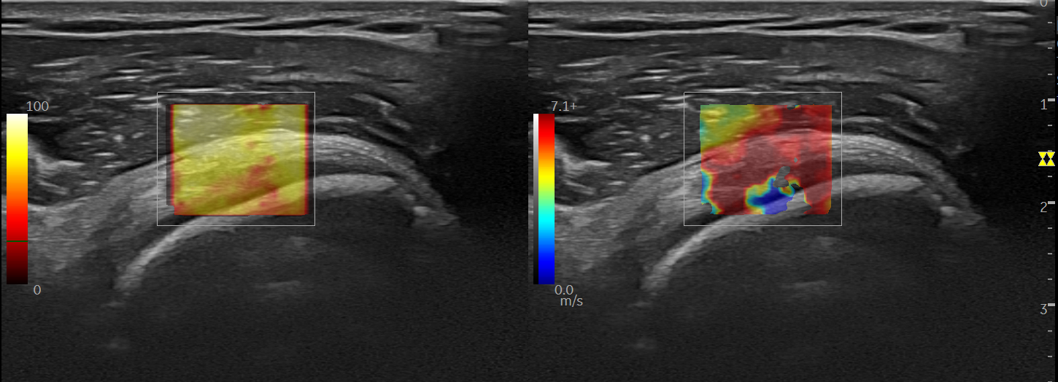
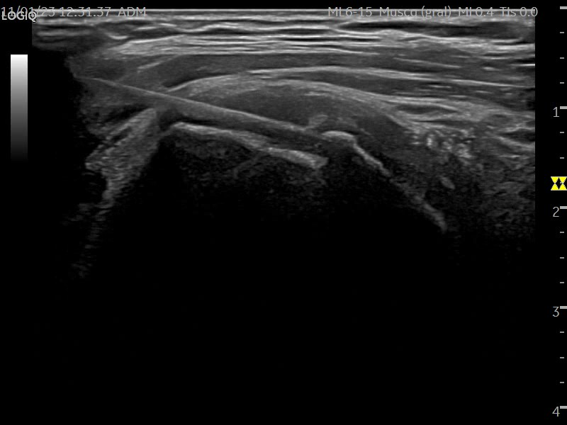
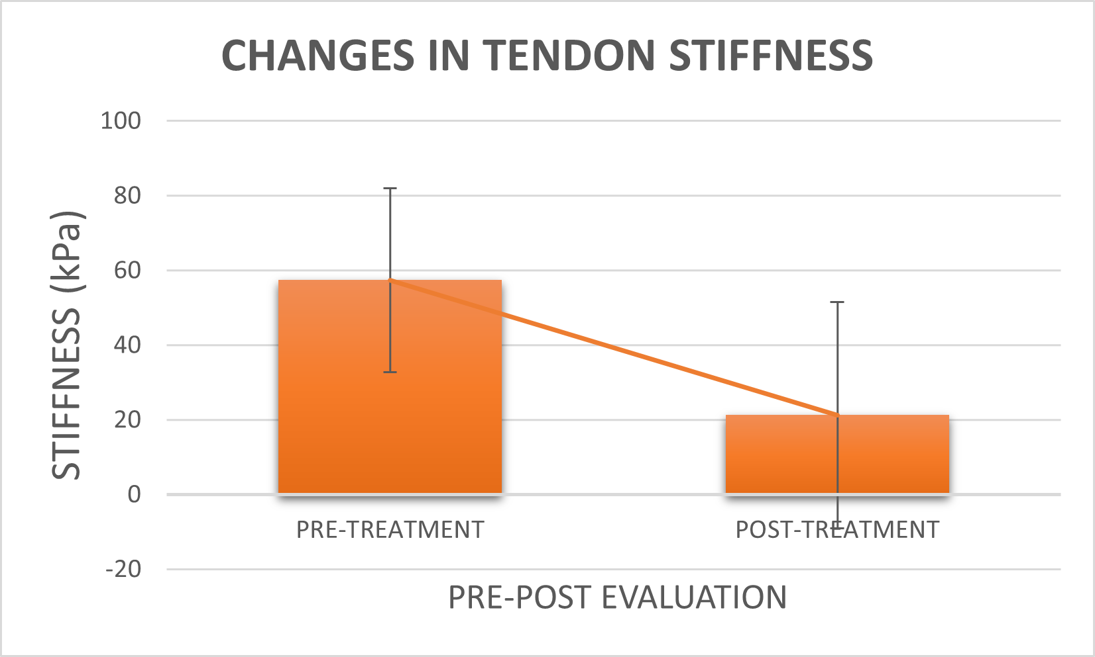
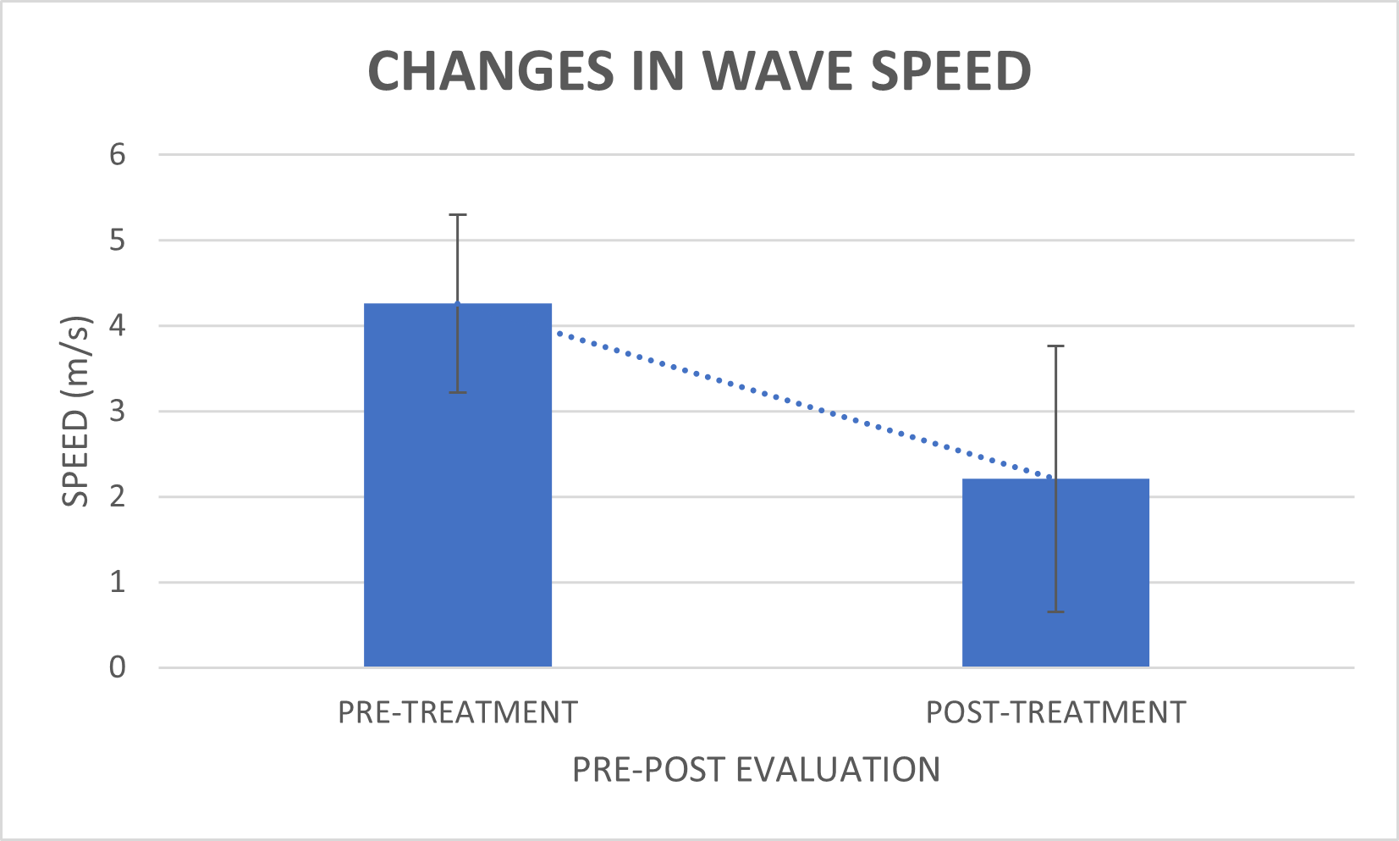
Immediate Changes In Quantitative Shear-Wave Elastography After Ultrasound-Guided Percutaneous Electrolysis In Supraspinatus Tendinopathy: A Case Report
Cancela-Cilleruelo I^{1,2}, Fernández-de-las-Peñas C², Rodríguez-Jiménez J², Arias-Buría JL².
¹ International Doctoral School, Rey Juan Carlos University, 29222 Alcorcón, Spain
² Department of Physical Therapy, Occupational Therapy, Rehabilitation and Physical Medicine, Rey Juan Carlos University, Alcorcón, Spain
1.
INTRODUCTION & OBJECTIVE
Elastography allows assessing soft tissue stiffness. Shear-wave elastography induces acoustic waves without manual external pressure, getting a more objective assessment.
Ultrasound-guided percutaneous electrolysis consists of the application of a galvanic current through a needle in the affected area.
The objective was to evaluate the effect of percutaneous electrolysis on supraspinatus tendon stiffness.
2.
METHODS
Case: ♀ - 67 y.o. Supraespinatus tendinopathy for 7 months. Pain 8/10 on Numeric Pain Rating Scale (NPRS).
Evaluation: Pre-post treatment elastography was performed. Region of interest (ROI) was 22.0 mm², taking 12 frames during 24.5”.
Treatment: Galvanic current dose of electrolysis was 2 mA x 20” (EPI® device), with an accumulated electric charge of 40 mC, combined with an eccentric exercise protocol.
3.
RESULTS
After treatment there was a significant immediate decrease in:
Stiffness: 49.85 (11.9) kPa (p<0.05)
Wave speed: 2.85 (0.4) m/s (p<0.05).
There was an immediate decrease of pain (p<0.05).
4.
CONCLUSION
The application of ultrasound-guided percutaneous electrolysis in the supraspinatus tendon was able to reduce stiffness immediately after its application.
This reduction in stiffness could be associated with an improvement in both structural and functional characteristics of the tendon, as well as in the patient's symptoms. However, no consensus exists on the normal values of tendon stiffness and the correlation between stiffness and clinical presentation.
This is a case report, accordingly studies with a larger sample size are required to obtain conclusive data.
#ISTStendon2023
6th International Scientific Tendinopathy Symposium ignacio.cancela@urjc.es

