Slide 1
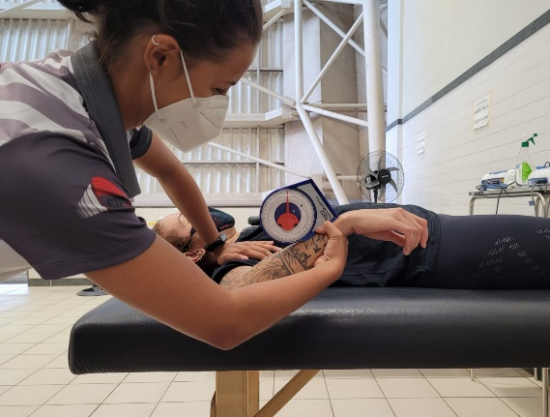
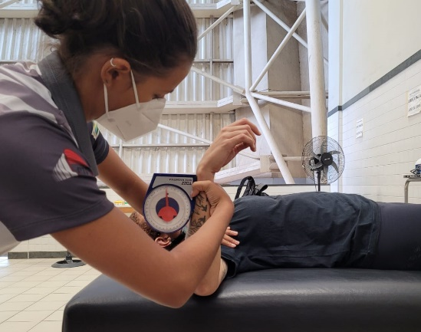
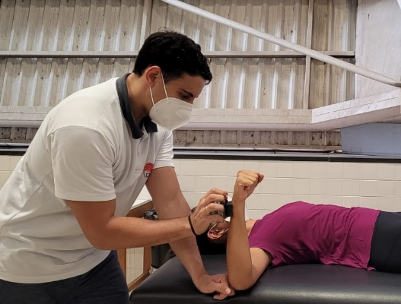
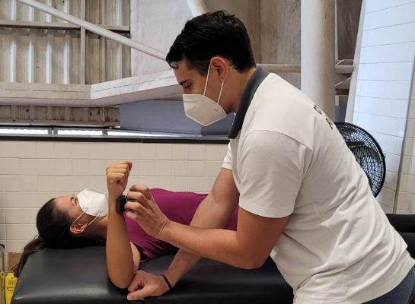
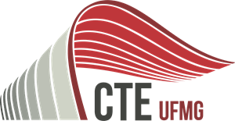
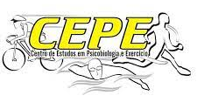
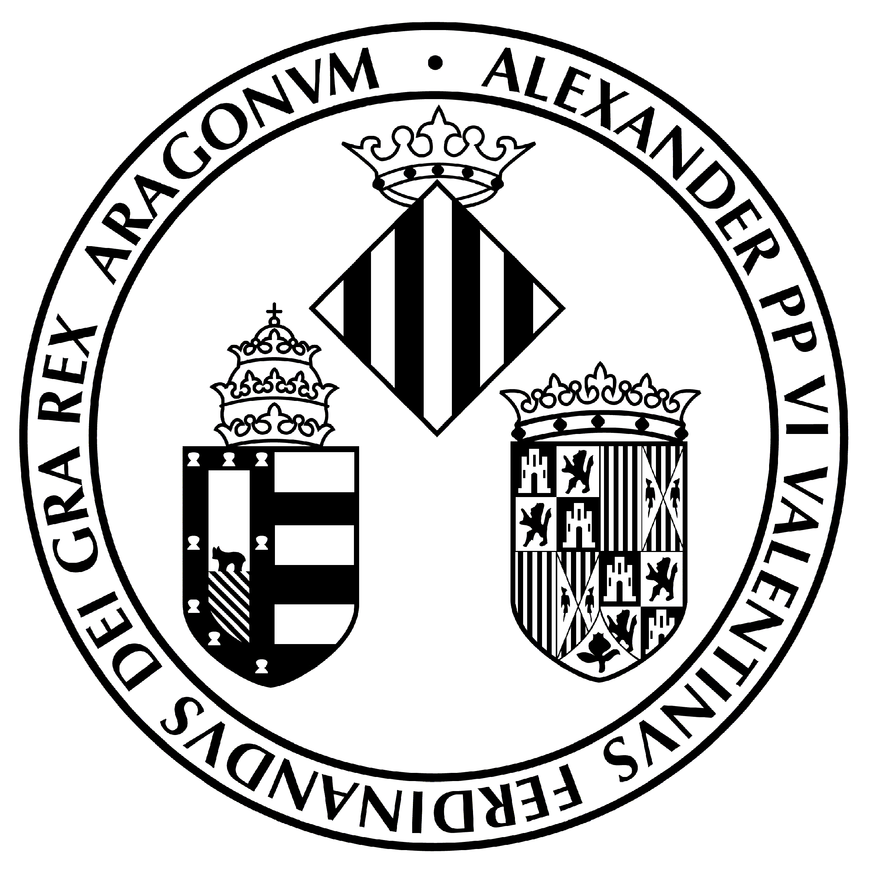
MUSCLE STRENGTH AND SHOULDER JOINT MOBILITY OF SWIMMING PARATHLETES
Sanchis, Geronimo José Bouzas^{1,2}, Resende, Renan¹, Barreto, Bruna¹, de Mello, Marco Tulio¹; Mohmara, Yasser²; Silva, Andressa^{1.}
1 – Federal University of Minas Gerais, Brazil 2 – University of Valencia, Spain
INTRODUCTION
Swimming is a sport with a high demand for the shoulder. Preseason evaluations are typical to find risk factors for musculoskeletal injuries and the performance of the athletes.
OBJECTIVE
Evaluate the range of motion (ROM) and muscle function of the shoulder and assess the difference in dominant sides and non-dominant of parathlete swimmers.
RESULTS
A total of 11 parathletes: eight males, eight with a physical disability, one with a visual disability, and two with an intellectual disability
METHODS
A cross-sectional observational study was conducted with parathletes from the Sports Training Center of the Federal University of Minas Gerais (CTE/UFMG).
To assess the ROM of the IR and ER movements of the shoulder, the protocol was used of Rosa, et al, 2019 (1), and to assess the isometric muscle strength of the IR and ER muscles of the shoulder, a portable dynamometer was used, and the isometric ratio calculated (ER/IR*10)(2).
Table 1. Studied variables and respective mean values, standard deviation (SD), and confidence intervals (CI).
 | Mean (SD) | CI (95%) | p
Range of Motion - Internal Rotation
Dominant | 46,5 (7,5) | 41 – 51,1
Non-dominat | 35,6 (16) | 22,1 – 49 | <0,01
Range of Motion – External Rotation
Dominant | 95 (10,1) | 87,7 – 102,2
Non-dominat | 90 (23,2) | 70,5 – 109,9 | <0,01
RI/RE Ratio
Dominant | 9,5 (1,7) | 8,4 – 10,7
Non-dominat | 8,4 (1,9) | 7,0 – 9,8 | <0,01
Figure 1 – Range of motion and strength isometric evaluation
CONCLUSION
The parathletes showed differences between the non-dominant and dominant sides for ROM/IR, ROM/ER, and the ER/IR ratio.
REFERENCES

