Slide 1


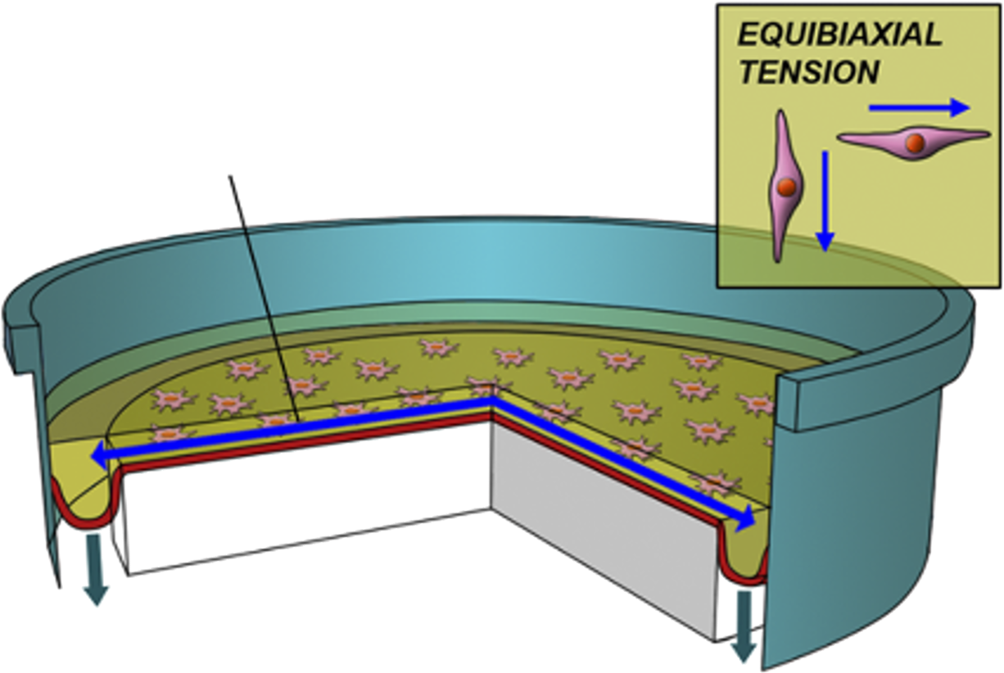
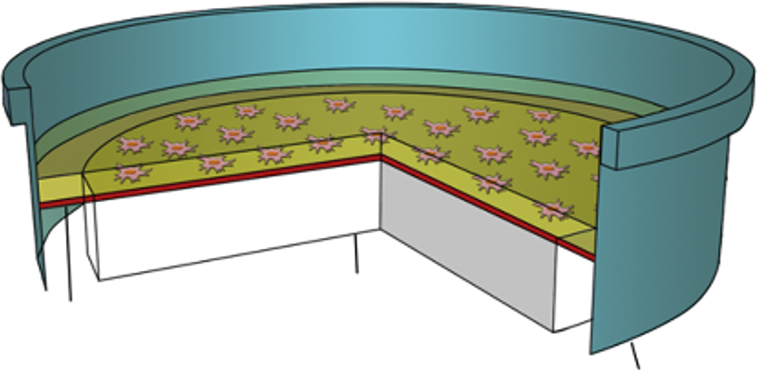
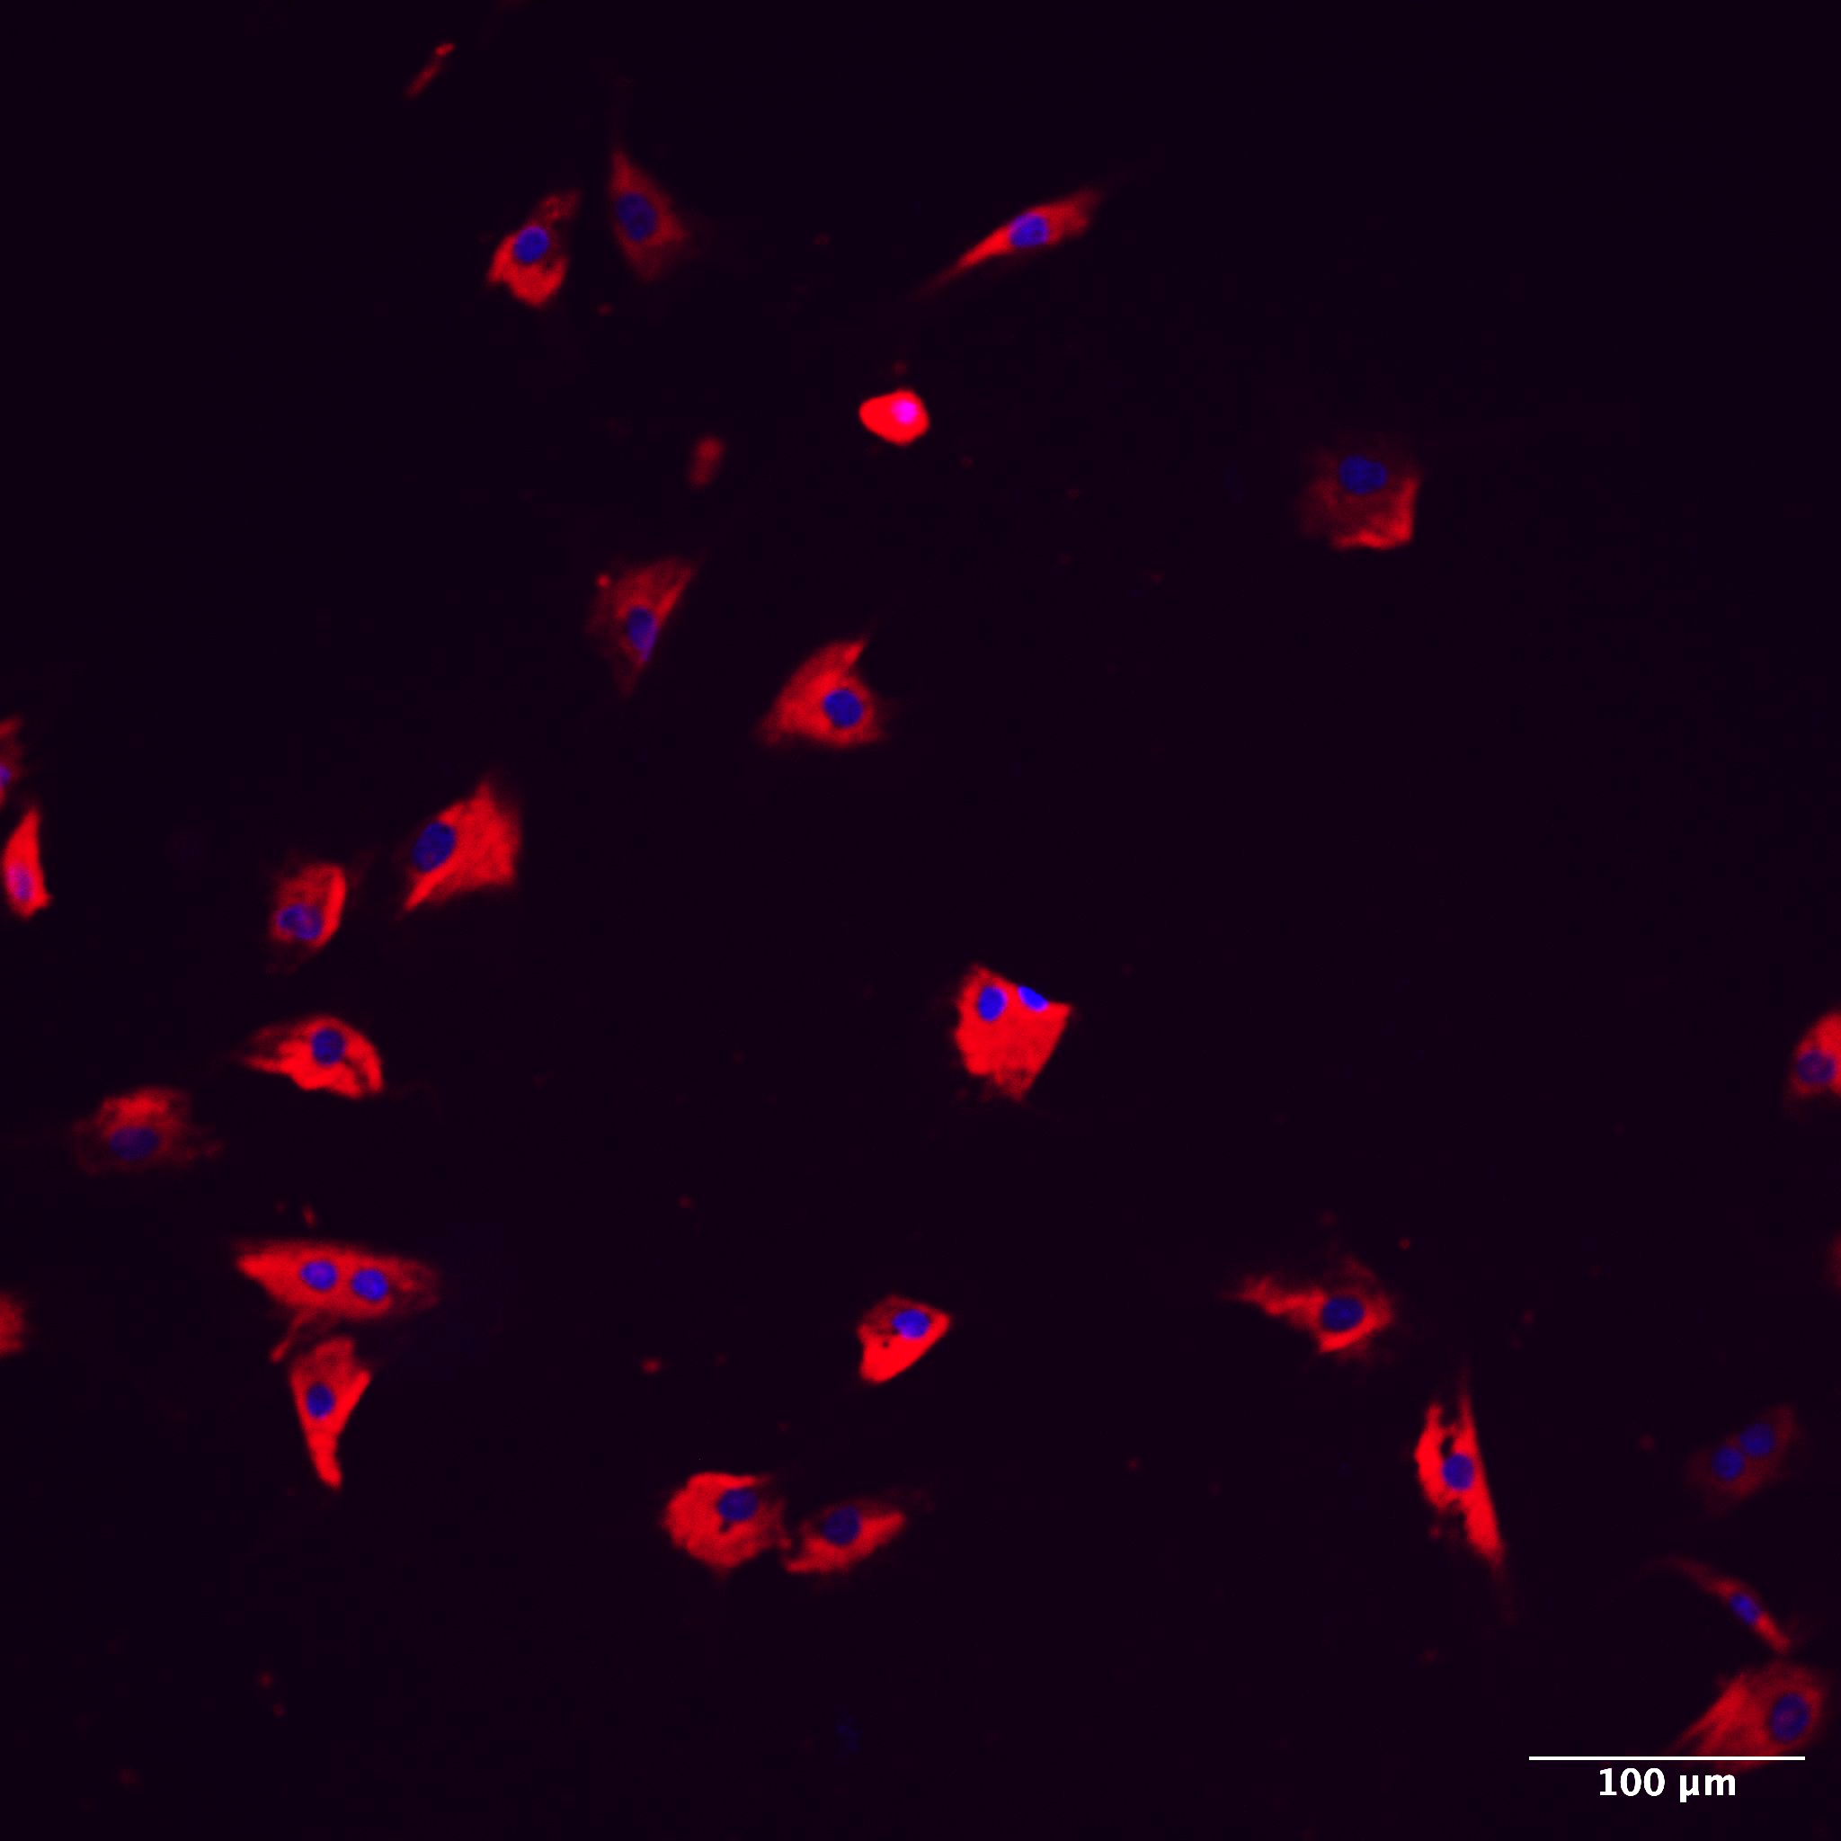
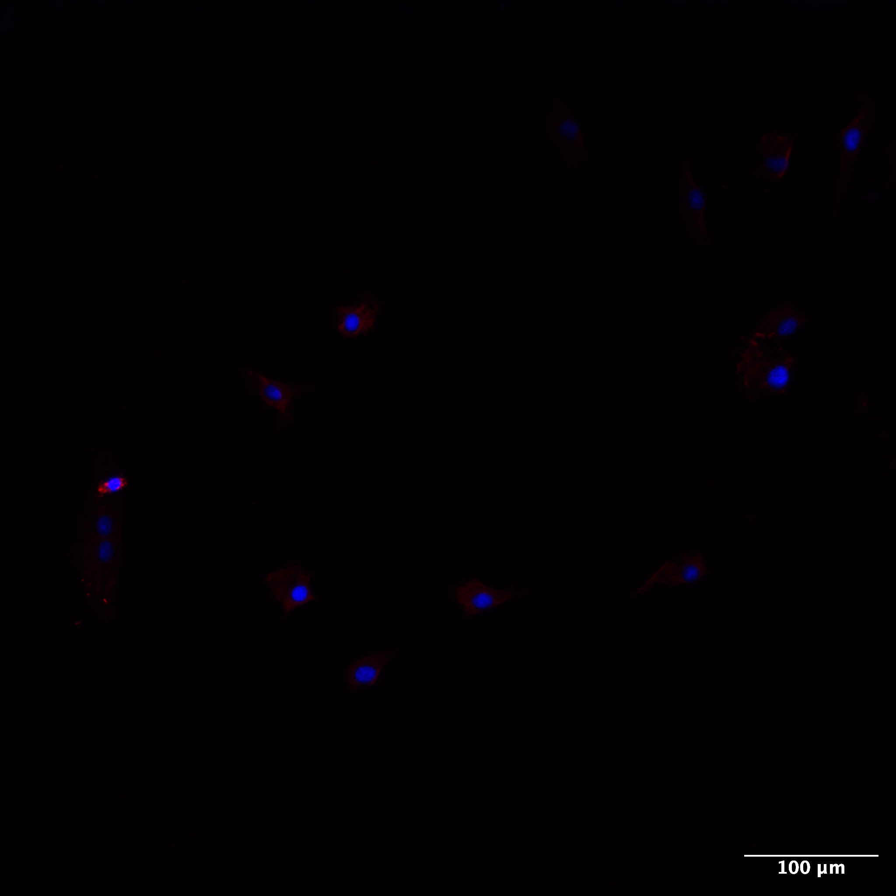


Loaded Muscle Secretome Increases Tendon Healing
Anders Eggert
Danielsson & Backman Laboratory
Introduction:
Secretome from statically loaded myoblast significantly increase parameters of tendon healing such as Collagen I/III ratio, Migration and cell phenotype as compared to dynamically loaded myoblasts.
Secreted protein, acidic and rich in cysteine, SPARC, is a protein known to be produced and secreted by muscles.
Hypothesis
We hypothesize that SPARC, secreted from muscle:
(1) is induced in statically loaded myoblasts and (2) stimulate collagen production in tendon cells.
SPARC
Method
Results
FlexCell© co-culture model
SPARC increases COL1
Inhibition of SPARC increase ACTA2 expression
BIOFLEX WELL
Equibiaxial tension
ACTA2
ACTA2
Rubber membrane
Loading post
Gasket
VACUUM
Phenotype
Phenotype
Results
SPARC
SPARC is up-regulated in statically loaded myoblast
COL1
COL1
Figures: 48h treatment. Intracellular expression
Figure: 24h treatment
Intracellular protein expression of COL1
Conclusion
2,5ug/ml SPARC
0ug/ml SPARC
SPARC expression is increased by statical loading
Neutralizing SPARC increases ACTA2 → SPARC is required for healthy tendon phenotype
Exogenous SPARC may increase tendon COL1/COL3 ratio → mimicking a healthier and stronger tendon
COL1
Collagen I
DAPI
Collagen I
DAPI
Figures: Immunocytochemistry of tenocytes exposed to exogenous SPARC for 48h.
Contact:
anmi0107@student.umu.se

