Slide 1
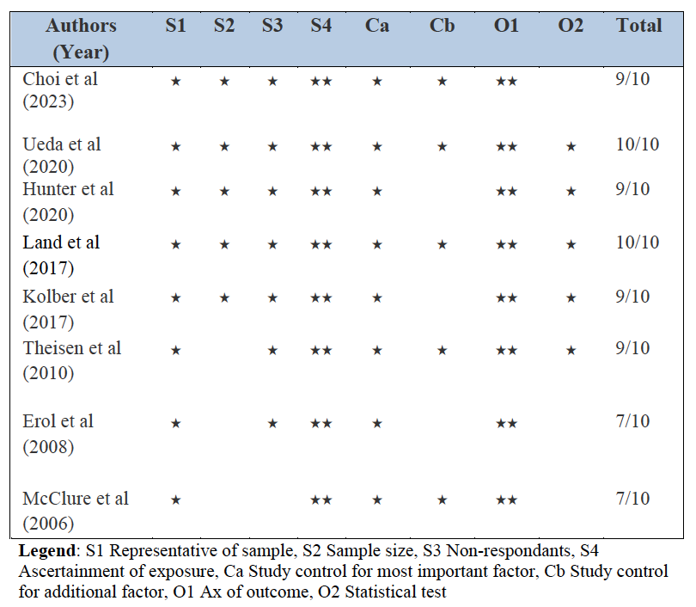
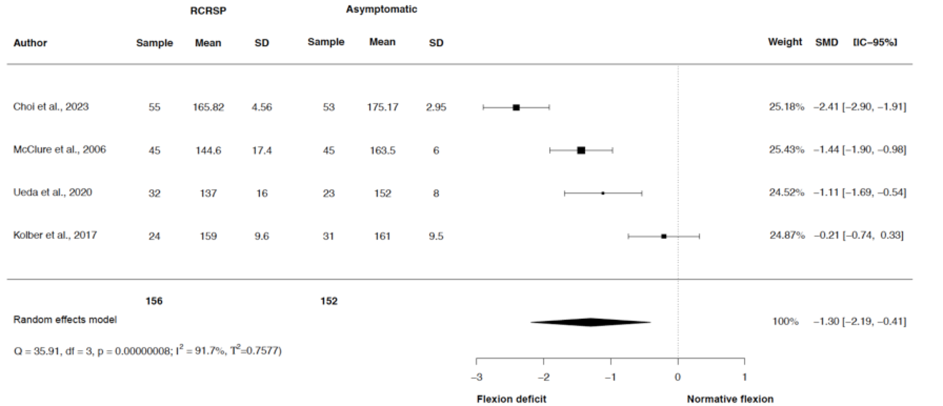
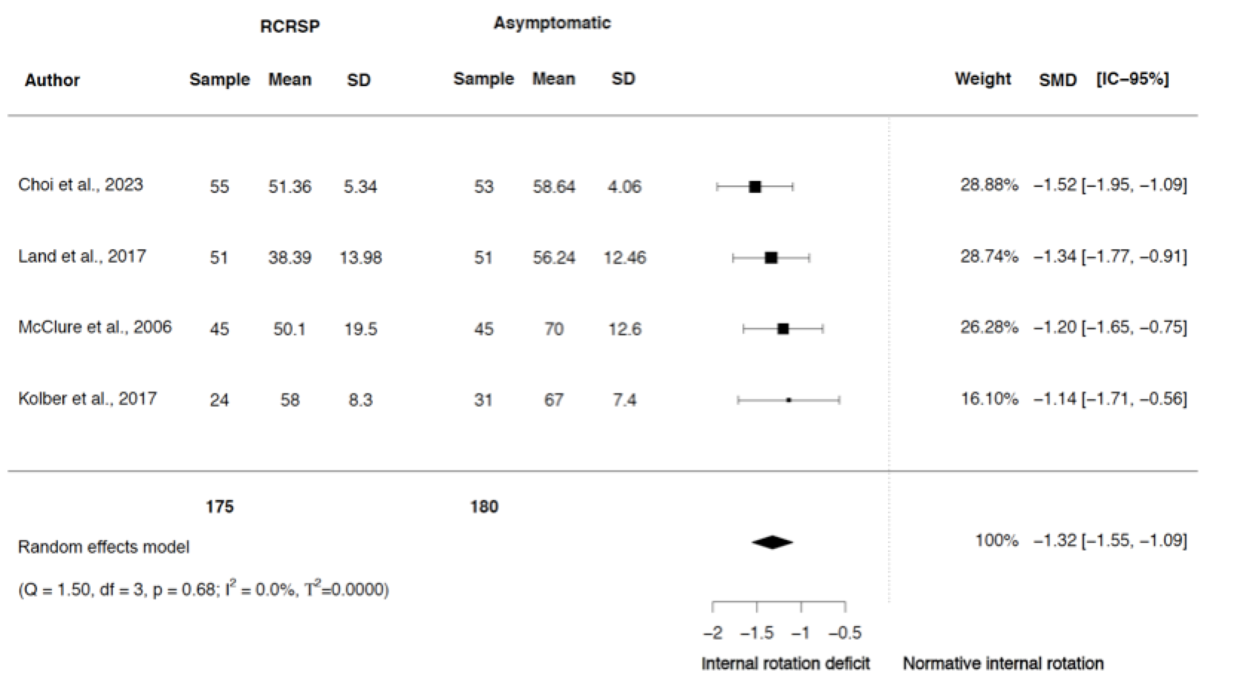
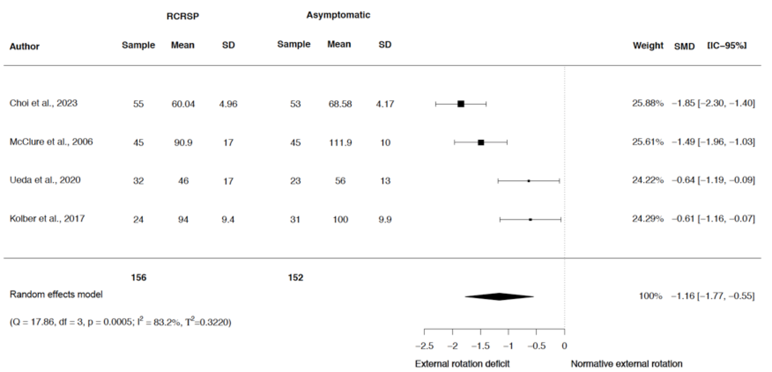
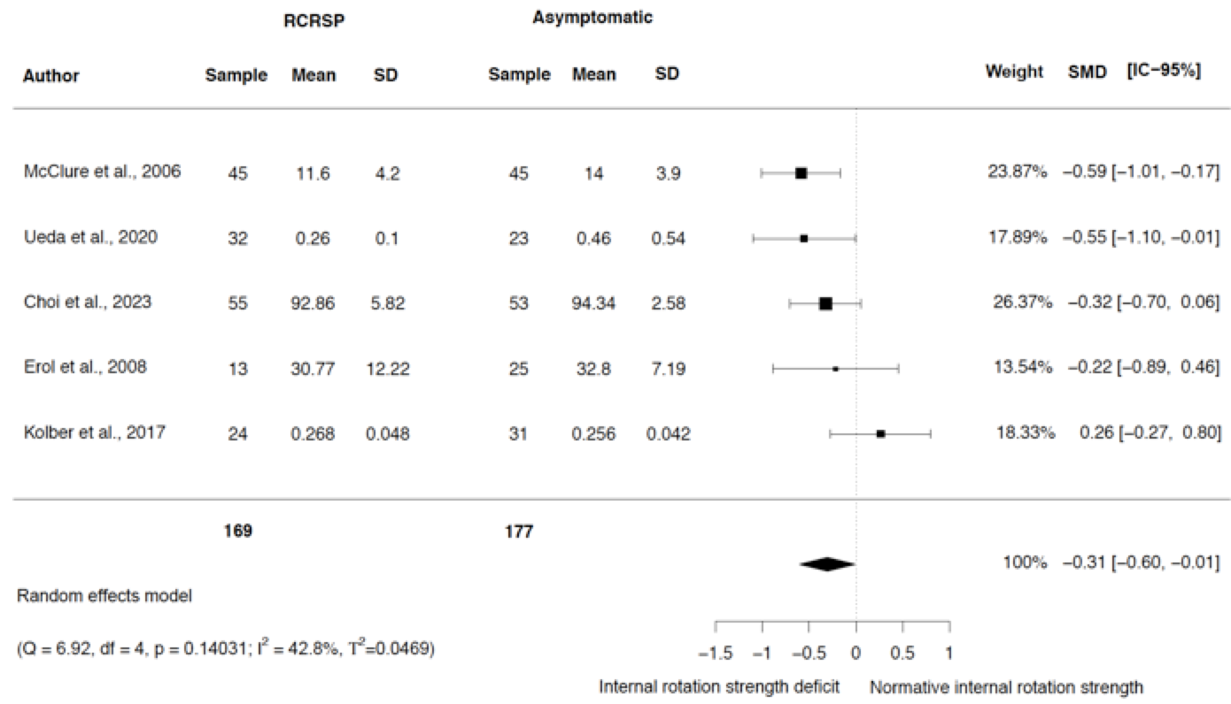
Shoulder Mobility And Strength Impairments In Patients With Rotator Cuff Related Shoulder Pain: A Systematic Review and Meta Analysis.
Manoso-Hernando D, Bailón-Cerezo J, Angulo-Díaz S, Reina-Varona A, Elizagaray-García I, Gil-Martínez A
INTRODUCTION
The methods previously proposed in the literature to assess patients with rotator cuff related shoulder pain (RCRSP), based on special orthopaedic tests, have been recently discarded. This study highlights the importance of considering shoulder range of motion (ROM) and strength in the examination process, as statistical differences have been reported in this meta-analysis.
OBJECTIVE
To summarize the shoulder physical examination characteristics in subjects with rotator cuff related shoulder pain and compare those with a healthy population.
The protocol was registered in PROSPERO (CRD42021258924).
Inclusion criteria Searching strategy Selection criteria and data extraction process: Two independent reviewers conducted the searching and the selection process according to PRISMA. Quality and qualitative analysis of the studies: The NOS adapted for cross-sectional studies was used. Data Synthesis and analysis: Same inclusion criteria plus 3 additional ones were used for the meta-analysis:1) in the results, there was detailed information regarding the comparative statistical data (mean, standard deviation, and 95% confidence interval) of the different variables related to the examination of the shoulder complex and the cervical spine 2) NOS scale ≥ 6 points was required 3) data of the analysed variables were represented in at least three studies. Presentation of summary statistics in the form of forest plots was used. The statistical significance of the pooled SMD was examined as Hedges’ g (Hg). The magnitude of Hg was interpreted according to a six-point scale: 1) <0.20 = insignificant effect; 2) 0.20‒0.60 = small effect; 3) 0.60‒1.20 = moderate effect; 4) 1.20-2 = large effect; 5) 2.00-4.00 = very large effect and 6) ≥4.00 = extremely large effect. Heterogeneity was estimated by the Cochran's Q statistic test (P < 0.05 is considered significant) or Inconsistency index (I²) (I² > 25% is considered to represent a small, I²>50% a medium, and I²>75% a large heterogeneity). An analysis was considered heterogeneous when fulfilling one or both conditions: 1) Q-test was significant (P < 0.05), 2) when Q-Test was not significant (P > 0.05) but the result of I² index was >50%.
METHODS
Cross-sectional, case-control or cohort observational studies were analysed.
Adults diagnosed with RCRSP compared to an asymptomatic group.
Studies should show a shoulder or neck neuro-musculoskeletal non-invasive physical examination in non-athlete patients diagnosed with RCRSP.
Exclusion criteria
Pilot studies or a study design other than a case control or cohort observational studies, such a randomised clinical trial or those with a validating design.
After the quality analysis, studies selected which scored was <6 points in the Newcastle-Ottawa scale (NOS), were excluded from the meta-analysis.
RESULTS
Quality analysis
Main Quantitative results
Synthesis forest plots: Shoulder Flexion ROM
Synthesis forest plots: Shoulder IR ROM
Synthesis forest plots: Shoulder ER ROM
Synthesis forest plots: Shoulder IR Strength
Legend: (*); p-value <0,05; (RCRSP): Rotator Cuff Related Shoulder Pain; (SD): Standard deviation; (CI): Confidence interval.
CONCLUSSION
REFERENCES
1. McClure PW, Michener LA, Karduna AR. Shoulder function and 3-dimensional scapular kinematics in people with and without shoulder impingement syndrome. Phys Ther. 2006;86(8):1075–90.
2. Land H, Gordon S, Watt K. Clinical assessment of subacromial shoulder impingement – Which factors differ from the asymptomatic population? Musculoskelet Sci Pract. 2017 Feb 1;27:49–56.
3. Kolber MJ, Hanney WJ, Cheatham SW, Salamh PA, Masaracchio M, Liu X. Shoulder Joint and Muscle Characteristics among Weight-Training Participants with and Without Impingement Syndrome. J Strength Cond Res. 2017 Apr 1;31(4):1024–32.
4. Hunter DJ, Rivett DA, McKeirnan S, Smith L, Snodgrass SJ. Relationship between Shoulder Impingement Syndrome and Thoracic Posture. Phys Ther. 2020 Apr 17;100(4):677–86.
5. Ueda Y, Tanaka H, Tomita K, Tachibana T, Inui H, Nobuhara K, et al. Comparison of shoulder muscle strength, cross-sectional area, acromiohumeral distance, and thickness of the supraspinatus tendon between symptomatic and asymptomatic patients with rotator cuff tears. J Shoulder Elb Surg. 2020 Oct 1;29(10):2043–50.
6. Erol Ö, Özçakar L, Çeliker R. Shoulder rotator strength in patients with stage I-II subacromial impingement: Relationship to pain, disability, and quality of life. J Shoulder Elb Surg. 2008 Nov;17(6):893–7.
7. Theisen C, Van Wagensveld A, Timmesfeld N, Efe T, Heyse TJ, Fuchs-Winkelmann S, et al. Co-occurrence of outlet impingement syndrome of the shoulder and restricted range of motion in the thoracic spine-a prospective study with ultrasound-based motion analysis. BMC Musculoskelet Disord. 2010;11.
8. Choi M, Chung J. Biomechanical and functional analysis of the shoulder complex and thoracic spine in patients with subacromial impingement syndrome: A case control study. Medicine (Baltimore). 2023 Jan 27;102(4):E32760.
There is moderate to strong evidence that patients with RCRSP present less shoulder flexion, internal and external rotation range of motion and less internal rotation strength than asymptomatic individuals.
CLINICAL IMPLICATIONS
Traditionally, orthopaedic shoulder test and later shoulder strength have been proposed to assess patients with RCRSP. In this meta-analysis, we highlight the importance of also including shoulder ROM as statistical differences have been found in shoulder flexion, external and internal rotation.

