Slide 1
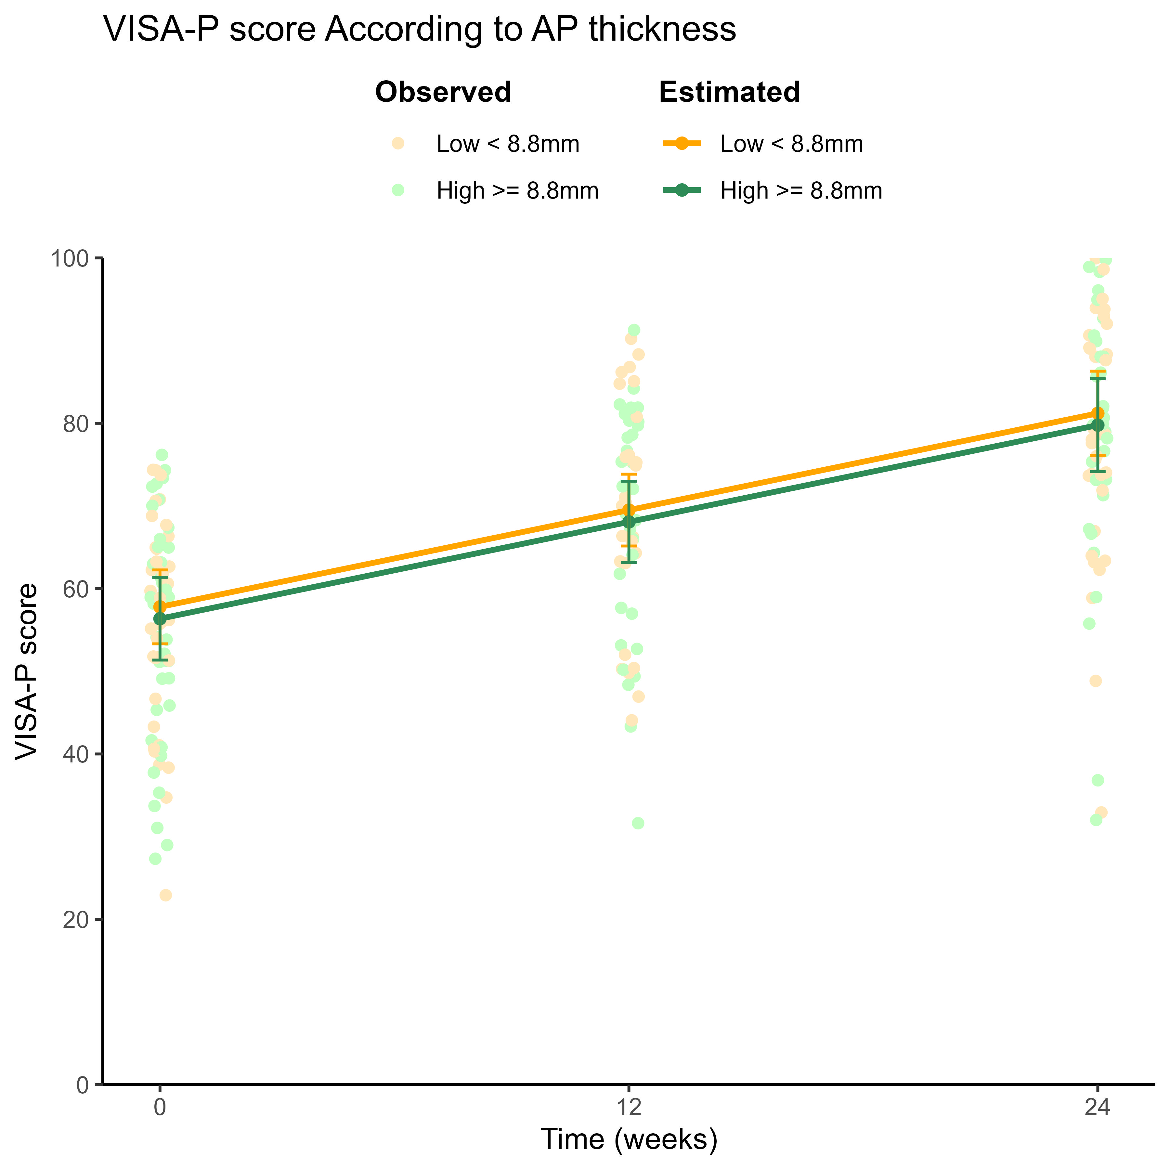
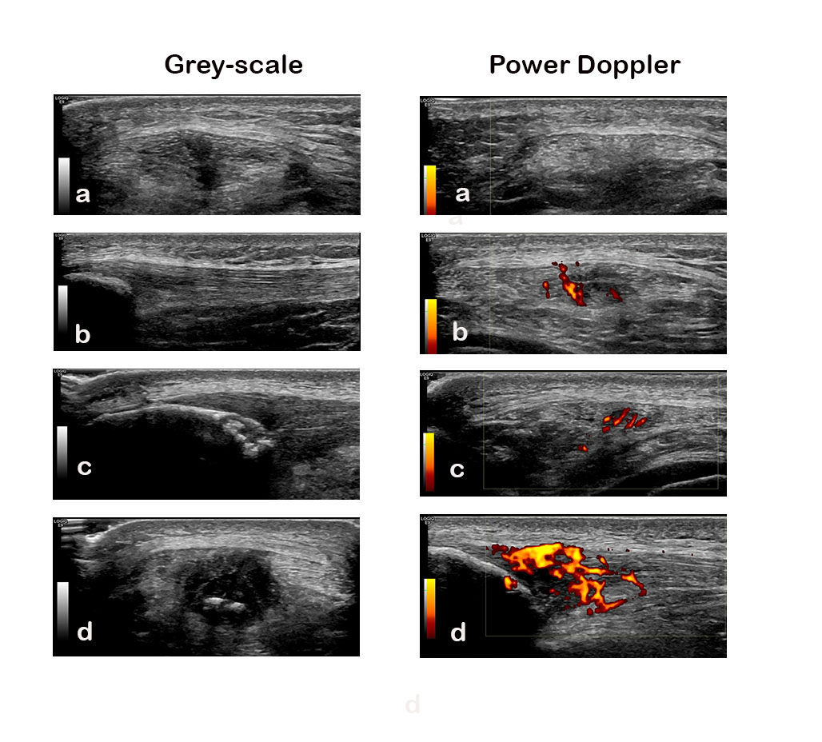


No association between ultrasound findings and symptoms in athletes with patellar tendinopathy performing exercise therapy
Deng J^{1,2}, Breda SJ^{1,2}, Eygendaal D¹, de Vos RJ¹, Oei EHG²
¹Department of Orthopedics and Sports Medicine, Erasmus MC University Medical Center, Rotterdam, the Netherlands
²Department of Radiology and Nuclear Medicine, Erasmus MC University Medical Center, Rotterdam, The Netherlands
Summary
Results
Baseline ultrasound findings were not associated with the 24-week change in symptoms in athletes with patellar tendinopathy performing exercise therapy.
Change in ultrasound findings was not associated with the change in clinical improvement during 24 weeks.
76 patients were included (mean age, 25 years; 58 male).
None of the baseline ultrasound findings were associated with VISA-P improvement over 24 weeks (all Pinteraction > 0.05)
24-week changes in ultrasound findings were not significantly associated with 24-week changes in VISA-P after adjustments (all P > 0.05).
Background
Exercise therapy remains the first-line conservative treatment in patellar tendinopathy[1]. However, around 20% of the patients do not experience a clinically relevant improvement after 24 weeks of exercise therapy[2].
Conventional ultrasound has gained tremendous popularity in musculoskeletal care. It is used to assist in diagnosis, estimating prognosis and monitoring treatment response[3-4].
There is a lack of evidence on:
the role of US findings in predicting the course of symptoms.
the association between the change in US findings and change in clinical symptoms during exercise therapy.
Aims
To investigate whether baseline ultrasound findings are associated with the course of symptom severity during 24 weeks in athletes with patellar tendinopathy performing exercise therapy.
To assess whether 24-week changes in ultrasound findings were associated with 24-week changes in symptom severity.
Methods
Implications for practice
We used prospective data from a randomized controlled trial that evaluated the effectiveness of exercise therapies in athletes with patellar tendinopathy[2].
Patellar tendon anteroposterior thickness, intratendinous calcifications, patella erosions, and gradation of Doppler flow using power Doppler ultrasound were collected at baseline,12 and 24 weeks.
The VISA-P questionnaire was used to assess symptom severity.
Linear mixed-effect models were used to detect the prognostic value of ultrasound
Multiple linear regression models were used to assess the association between changes in ultrasound findings and change in VISA-P during 24 weeks.
Our results do not support using findings from conventional ultrasound to estimate prognosis for athletes with patellar tendinopathy, nor does it support that clinical improvement during exercise therapy is associated with changes in ultrasound findings.
References
[1] Millar NL, Silbernagel KG, Thorborg K, Kirwan PD, Galatz LM, Abrams GD, et al. Tendinopathy. Nat Rev Dis Primers. 2021;7(1):1.
[2] Breda SJ, Oei EHG, Zwerver J, Visser E, Waarsing E, Krestin GP, et al. Effectiveness of progressive tendon-loading exercise therapy in patients with patellar tendinopathy: a randomised clinical trial. Br J Sports Med. 2021;55(9):501-9.
[3] Docking SI, Ooi CC, Connell D. Tendinopathy: Is Imaging Telling Us the Entire Story? J Orthop Sports Phys Ther. 2015;45(11):842-52.
[4] Rabello LM, van den Akker-Scheek I, Brink MS, Maas M, Diercks RL, Zwerver J. Association Between Clinical and Imaging Outcomes After Therapeutic Loading Exercise in Patients Diagnosed With Achilles or Patellar Tendinopathy at Short- and Long-Term Follow-up: A Systematic Review. Clin J Sport Med. 2020;30(4):390-403.
Jie Deng, MD
https://twitter.com/jiedeng5

